Slide 1
Introduction to Data Science
Unit-1

Slide 2

Data Science Process
The statistician William S. Cleveland defined data science as an interdisciplinary field larger than statistics itself.
We define data science as managing the process that can transform hypotheses and data into actionable predictions.
Typical predictive analytic goals include predicting who will win an election, what products will sell well together, which loans will default, and which advertisements will be clicked on.
The data scientist is responsible for acquiring and managing the data, choosing the modeling technique, writing the code, and verifying the results.
Because data science draws on so many disciplines, many of the best data scientists we meet started as programmers, statisticians, business intelligence analysts, or scientists.
By adding a few more techniques to their repertoire, they became excellent data scientists.

Slide 3
Examples
Much of the theoretical basis of data science comes from statistics.
But data science as we know it is strongly influenced by technology and software engineering methodologies, and has largely evolved in heavily computer science– and information technology– driven groups.
Engineering flavor of data science - some famous examples:
Amazon’s product recommendation systems
Google’s advertisement valuation systems
LinkedIn’s contact recommendation system
Twitter’s trending topics
Walmart’s consumer demand projection systems

Slide 4
Features
All of these systems are built off large datasets. That’s not to say they’re all in the realm of big data. But none of them could’ve been successful if they’d only used small datasets. To manage the data, these systems require concepts from computer science: database theory, parallel programming theory, streaming data techniques, and data warehousing.
Most of these systems are online or live. Rather than producing a single report or analysis, the data science team deploys a decision procedure or scoring procedure to either directly make decisions or directly show results to a large number of end users. The production deployment is the last chance to get things right, as the data scientist can’t always be around to explain defects.
All of these systems are allowed to make mistakes at some non-negotiable rate.
None of these systems are concerned with cause. They’re successful when they find useful correlations and are not held to correctly sorting cause from effect.

Slide 5
Supplementary material
https://github.com/WinVector/PDSwR2
Beyond Spreadsheets with R by Jonathan Carroll (Manning, 20108) or
R in Action by Robert Kabacoff (now available in a second edition http://www.manning.com/kabacoff2/), along with the text’s associated website
Quick-R (http://www.statmethods.net).
For statistics, we recommend Statistics, Fourth Edition, by David Freedman, Robert Pisani, and Roger Purves (W. W. Norton & Company, 2007).
zip file (https://github.com/WinVector/PDSwR2/raw/master/CodeExamples.zip)
https://forums.manning.com/forums/practical-data-science-with-rsecond-edition

Slide 6
Defining Data Science
Data science is a cross-disciplinary practice that draws on methods from data engineering, descriptive statistics, data mining, machine learning, and predictive analytics.
Much like operations research, data science focuses on implementing data-driven decisions and managing their consequences.
The data scientist is responsible for guiding a data science project from start to finish.
Success in a data science project comes not from access to any one exotic tool, but from having quantifiable goals, good methodology, cross-discipline interactions, and a repeatable workflow.

Slide 7
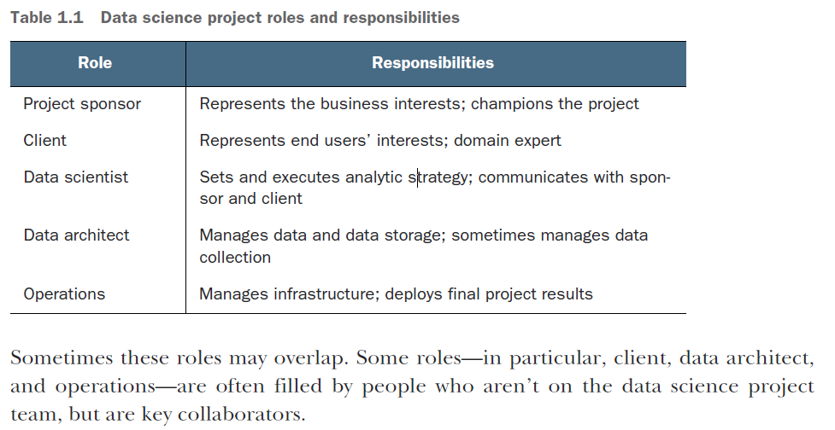
Roles in a Data Science Project

Slide 8
Roles – Project Sponsor
Suppose you’re working for a German bank. The bank feels that it’s losing too much money to bad loans and wants to reduce its losses. To do so, they want a tool to help loan officers more accurately detect risky loans.
The most important role in a data science project is the project sponsor. The sponsor is the person who wants the data science result; generally, they represent the business interests.
The sponsor is responsible for deciding whether the project is a success or failure. The data scientist may fill the sponsor role for their own project if they feel they know and can represent the business needs, but that’s not the optimal arrangement.
The ideal sponsor meets the following condition: if they’re satisfied with the project outcome, then the project is by definition a success.
Getting sponsor sign-off becomes the central organizing goal of a data science project.
In the loan application example, the sponsor might be the bank’s head of Consumer Lending.
To ensure sponsor sign-off, you must get clear goals from them through directed interviews. You attempt to capture the sponsor’s expressed goals as quantitative statements. An example goal might be “Identify 90% of accounts that will go into default at least two months before the first missed payment with a false positive rate of no more than 25%.”

Slide 9
Roles – Client
While the sponsor is the role that represents the business interests, the client is the role that represents the model’s end users’ interests.
Sometimes, the sponsor and client roles may be filled by the same person. Again, the data scientist may fill the client role if they can weight business trade-offs, but this isn’t ideal.
The client is more hands-on than the sponsor; they’re the interface between the technical details of building a good model and the day-to-day work process into which the model will be deployed.
They aren’t necessarily mathematically or statistically sophisticated, but are familiar with the relevant business processes and serve as the domain expert on the team.
In the loan application example, the client may be a loan officer or someone who represents the interests of loan officers.
As with the sponsor, you should keep the client informed and involved. Ideally, you’d like to have regular meetings with them to keep your efforts aligned with the needs of the end users.
Generally, the client belongs to a different group in the organization and has other responsibilities beyond your project. Keep meetings focused, present results and progress in terms they can understand, and take their critiques to heart.
If the end users can’t or won’t use your model, then the project isn’t a success, in the long run.

Slide 10
Data Scientist
The next role in a data science project is the data scientist, who’s responsible for taking all necessary steps to make the project succeed, including setting the project strategy and keeping the client informed.
They design the project steps, pick the data sources, and pick the tools to be used. Since they pick the techniques that will be tried, they have to be well informed about statistics and machine learning.
They’re also responsible for project planning and tracking, though they may do this with a project management partner.
At a more technical level, the data scientist also looks at the data, performs statistical tests and procedures, applies machine learning models, and evaluates results—the science portion of data science.

Slide 11
Data Architect
The data architect is responsible for all the data and its storage.
Often this role is filled by someone outside of the data science group, such as a database administrator or architect.
Data architects often manage data warehouses for many different projects, and they may only be available for quick consultation.

Slide 12
Operations
The operations role is critical both in acquiring data and delivering the final results.
The person filling this role usually has operational responsibilities outside of the data science group.
For example, if you’re deploying a data science result that affects how products are sorted on an online shopping site, then the person responsible for running the site will have a lot to say about how such a thing can be deployed.
This person will likely have constraints on response time, programming language, or data size that you need to respect in deployment.
The person in the operations role may already be supporting your sponsor or your client, so they’re often easy to find (though their time may be already very much in demand).

Slide 13
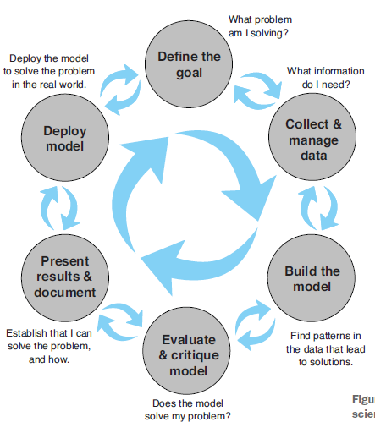
Stages of a Data Science Project
The ideal data science environment is one that encourages feedback and iteration between the data scientist and all other stakeholders.
This is reflected in the lifecycle of a data science project.

Slide 14
Defining the Goal
The first task in a data science project is to define a measurable and quantifiable goal. At this stage, learn all that you can about the context of your project:
Why do the sponsors want the project in the first place? What do they lack, and what do they need?
What are they doing to solve the problem now, and why isn’t that good enough?
What resources will you need: what kind of data and how much staff? Will you have domain experts to collaborate with, and what are the computational resources?
How do the project sponsors plan to deploy your results? What are the constraints that have to be met for successful deployment?
Once you and the project sponsor and other stakeholders have established preliminary answers to these questions, you and they can start defining the precise goal of the project.
The goal should be specific and measurable; not “We want to get better at finding bad loans,” but instead “We want to reduce our rate of loan charge-offs by at least 10%, using a model that predicts which loan applicants are likely to default.”

Slide 15
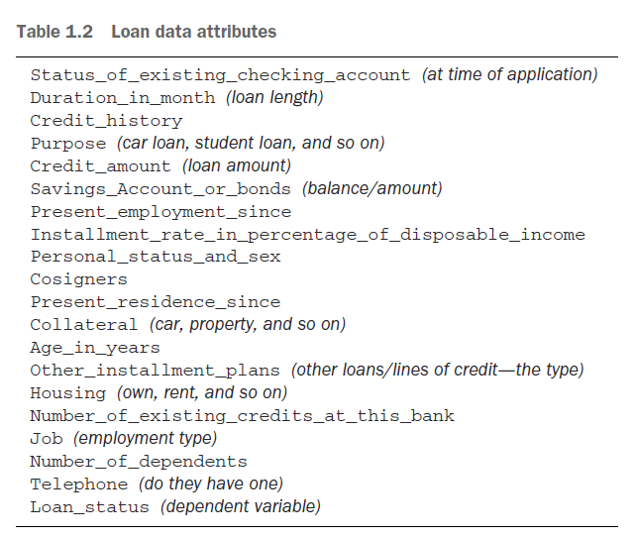
Data Collection and Management
This step encompasses identifying the data you need, exploring it, and conditioning it to be suitable for analysis. This stage is often the most time-consuming step in the process. It’s also one of the most important:
What data is available to me?
Will it help me solve the problem?
Is it enough?
Is the data quality good enough?

Slide 16
Modelling
The most common data science modeling tasks are these:
Classifying—Deciding if something belongs to one category or another
Scoring—Predicting or estimating a numeric value, such as a price or probability
Ranking—Learning to order items by preferences
Clustering—Grouping items into most-similar groups
Finding relations—Finding correlations or potential causes of effects seen in the data
Characterizing—Very general plotting and report generation from data
The loan application problem is a classification problem: you want to identify loan applicants who are likely to default.

Slide 17
Model Evaluation and Critique
Once you have a model, you need to determine if it meets your goals:
Is it accurate enough for your needs? Does it generalize well?
Does it perform better than “the obvious guess”? Better than whatever estimate you currently use?
Do the results of the model (coefficients, clusters, rules, confidence intervals, significances, and diagnostics) make sense in the context of the problem domain?
Confusion Matrix

Slide 18
Presentation and Documentation
A presentation for the model’s end users (the loan officers) would instead emphasize how the model will help them do their job better:
How should they interpret the model?
What does the model output look like?
If the model provides a trace of which rules in the decision tree executed, how do they read that?
If the model provides a confidence score in addition to a classification, how should they use the confidence score?
When might they potentially overrule the model?

Slide 19
Model Deployment and Maintenance

